Slide 1
Capstone Project-2
Ted Talks Views Prediction
Regression
By
Adil Imam
Asadullakhan Pathan
Md Sazil Sharif
Sushil Kumar Singh
Data Science Trainee, AlmaBetter

Slide 2
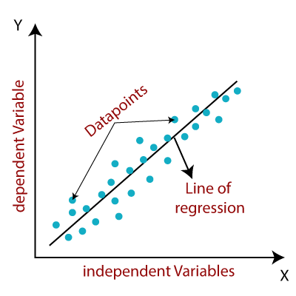
What is machine learning regression?
Regression is a method for understanding the relationship between independent variables or features and a dependent variable or outcome. Outcomes can then be predicted once the relationship between independent and dependent variables has been estimated. Regression is a field of study in statistics which forms a key part of forecast models in machine learning. It’s used as an approach to predict continuous outcomes in predictive modelling, so has utility in forecasting and predicting outcomes from data. Machine learning regression generally involves plotting a line of best fit through the data points. The distance between each point and the line is minimised to achieve the best fit line.
Common use for machine learning regression models include:
Forecasting continuous outcomes like house prices, stock prices, or sales.
Predicting the success of future retail sales or marketing campaigns to ensure resources are used effectively.
Predicting customer or user trends, such as on streaming services or ecommerce websites.
Analysing datasets to establish the relationships between variables and an output.
Predicting interest rates or stock prices from a variety of factors.
Creating time series visualisations.

Slide 3
Discussion points
1. Problem statement
2. Data Summary
3. Exploratory Data Analysis
4. Feature Engineering
5. Feature selection
6. Modelling
7. Model Selection
8. Challenges
9. Conclusion

Slide 4
Problem Statement
TED is devoted to spreading powerful ideas on just about any topic. These datasets contain over 4,000 TED talks including transcripts in many languages Founded in 1984 by Richard Salman as a nonprofit organization that aimed at bringing experts from the fields of Technology, Entertainment, and Design together,
TED Conferences have gone on to become the Mecca of ideas from virtually all
walks of life. As of Oct 2020, TED and its sister TEDx chapters have published more than 3500 talks for free consumption by the masses and its speaker list boasts of the likes of Al Gore, Jimmy Wales, Shahrukh Khan, and Bill Gates.
The main objective is to build a predictive model, which could help in predicting the views of the videos uploaded on the TEDx website.

Slide 5
Data Summary
Dataset name: data_ted_talks
Shape:
Rows = 4005
Columns = 19
Features:
'talk_id', 'title', 'speaker_1', 'all_speakers', 'occupations’, 'about_speakers', 'views',
'recorded_date', 'published_date', 'event’, 'native_lang', 'available_lang', 'comments', 'duration', 'topics', 'related_talks', 'url', 'description', 'transcript’
Target variable : ‘views’

Slide 6
Exploratory Data Analysis

Slide 7
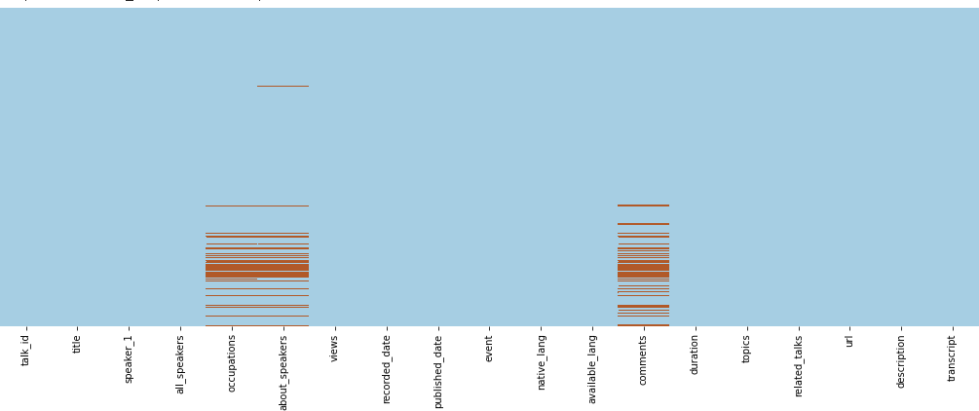
Handling Missing values
For numerical feature:
used KNN Imputer to
impute missing values
For categorical features:
Replaced Nan values with
‘Unknown’ category

Slide 8
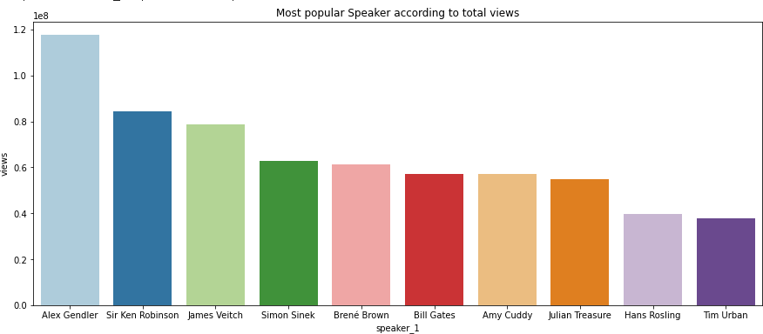
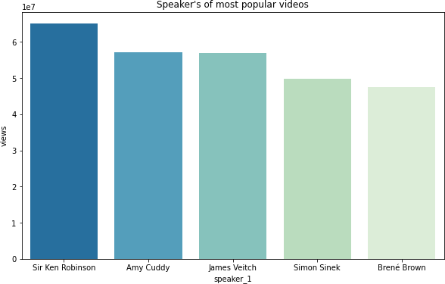
Overview of Speaker column
Sir Ken Robinson's talk on "Do Schools Kill Creativity?" is the most popular TED Talk
with more than 65 million views.
Alex Gendler is the most popular speaker wrt to total views followed by Sir Ken
Robinson

Slide 9
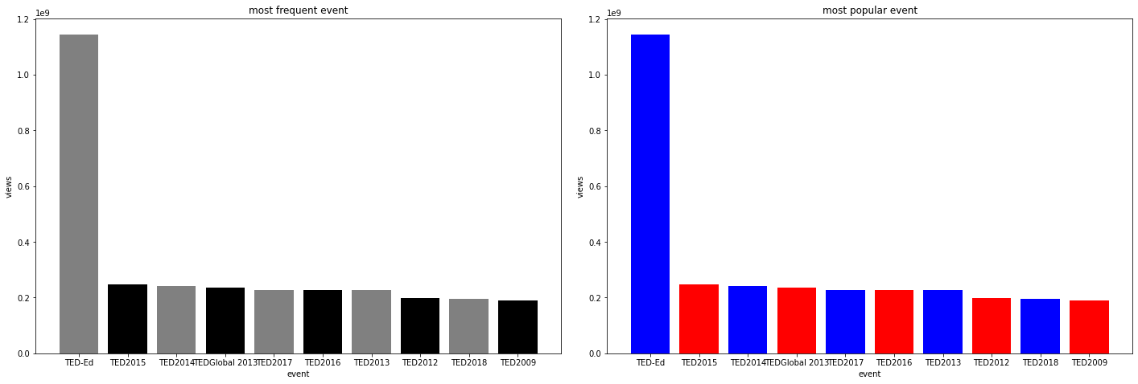
Which is the most popular and frequent event?
TED-Ed is the most frequent event category with 556 entries followed by TED2017 and TED2018

Slide 10
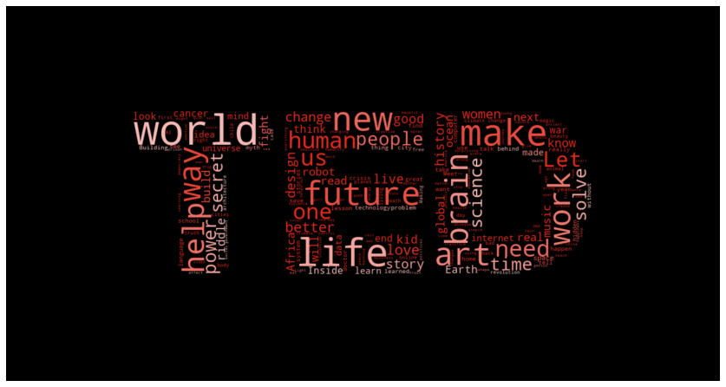
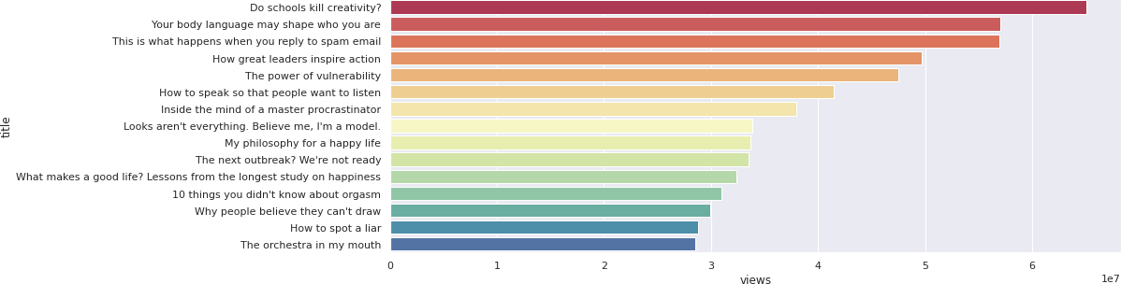
Most popular title?
Most popular title:
Do schools kill creativity with 65M views

Slide 11
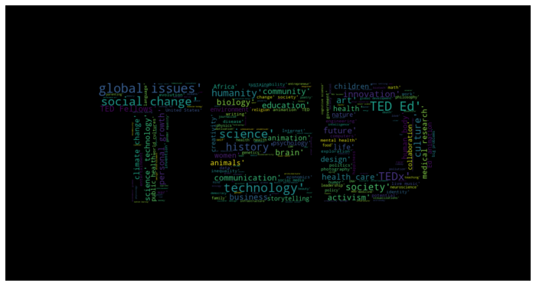
Most popular topic tags?
Most popular tags are global issues, technology, science Ted ED, social change

Slide 12
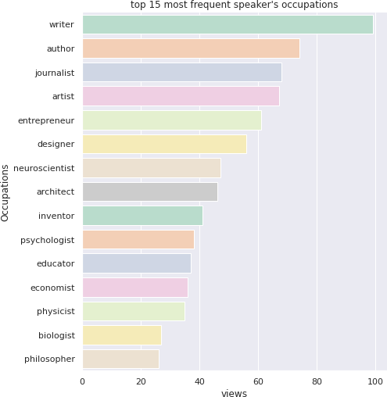
Most frequent Speaker’s occupations
Writer is the most frequent speaker’s
occupation followed by author and
journalist

Slide 13
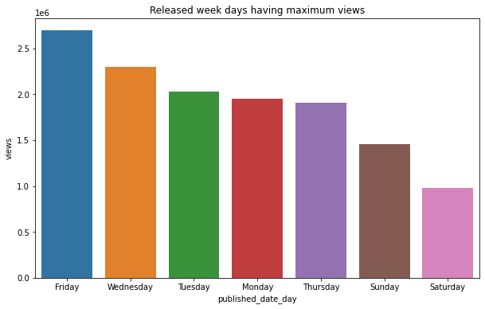
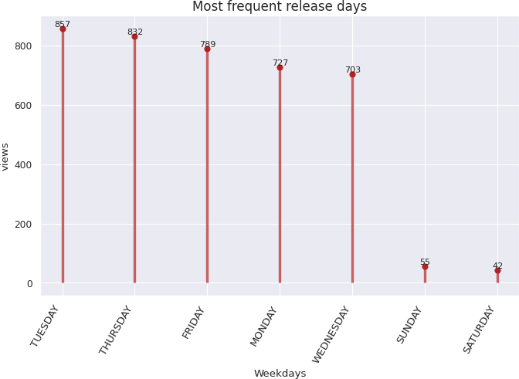
Overview of published_date
Most videos are published on Tuesday followed by Thursday
But the videos published on Friday are more popular

Slide 14
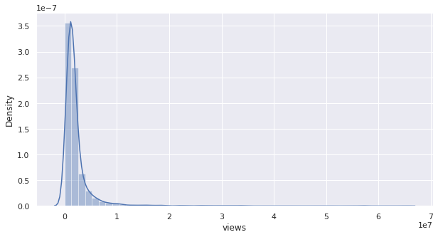
Checking the skewness of our target variable
As we can see from the above graph Our target variable is rightly skewed

Slide 15
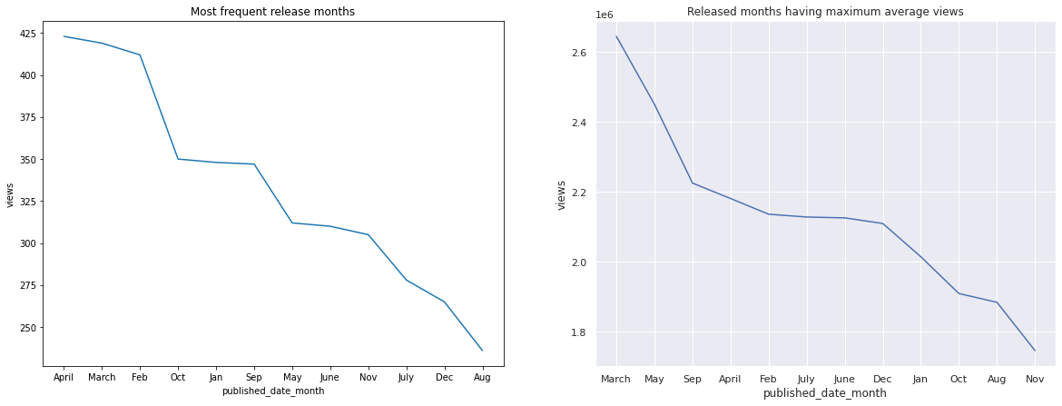
Published month overview
April have maximum released videos. But the videos released in March are
more popular

Slide 16
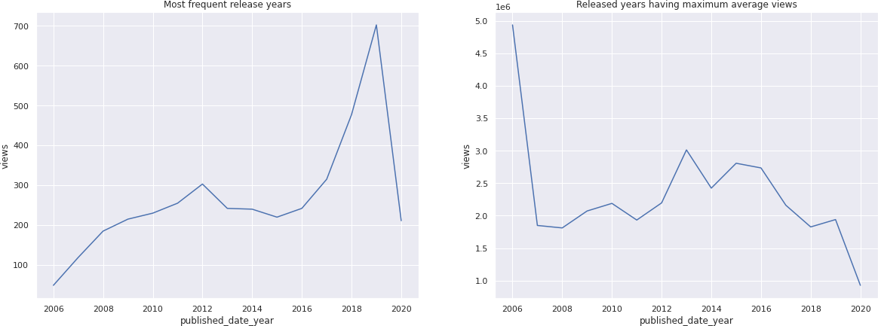
Published year overview
Most videos are published in 2019. But videos in 2006 are most viewed

Slide 17
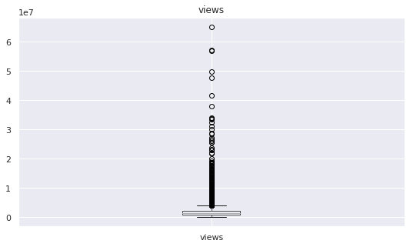
Outlier treatment
Before the treatment
views 393
comments 261
duration 21
speaker_1_avg_views 373
event_wise_avg_views 156
num_of_tags 116
topics_wise_avg_views 242
num_of_lang 121
video_age 0
related_talks_views 300
dtype: int64
After treatment
views 0
comments 0
duration 0
speaker_1_avg_views 0
event_wise_avg_views 0
num_of_tags 0
topics_wise_avg_views 0
num_of_lang 0
video_age 0
related_talks_views 0
dtype: int64
We have outliers in few columns which needs to be treated well. I am replacing the outliers with the extreme values..

Slide 18
Feature Engineering
1. speaker_1_avg_views
2. event_wise_avg_views
3. num_of_tags
4. topics_wise_avg_view
5. num_of_lang
6. video_age
7. related_talks_views
Due to high number of cardinality in Speaker_1 and event Column, therefore applied mean encoding
In Mean Encoding each distinct value of categorical value is replaced with average value of
target variable

Slide 19
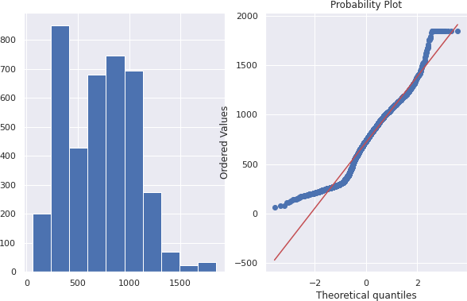
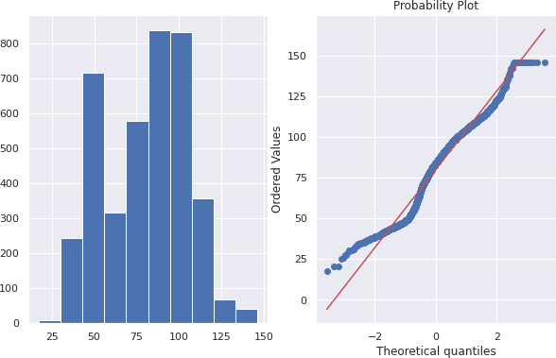
Transformations
Applied on the following features:
Comments
Duration
event_wise_avg_views
num_of_tags
topics_wise_avg_views
num_of_lang
video_age
related_talks_views
speaker_1_avg_views

Slide 20
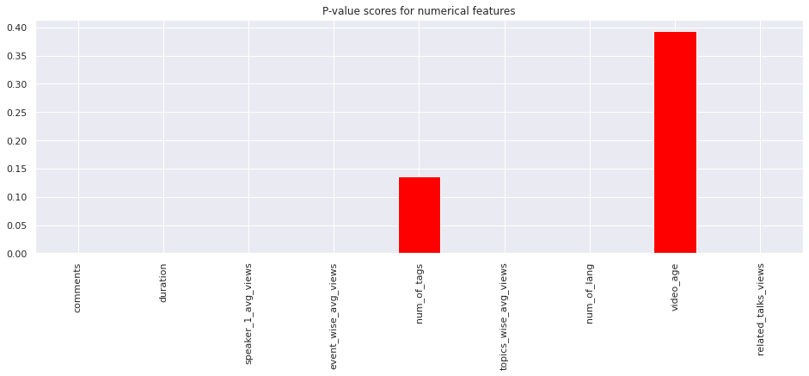
Feature selection

Slide 21
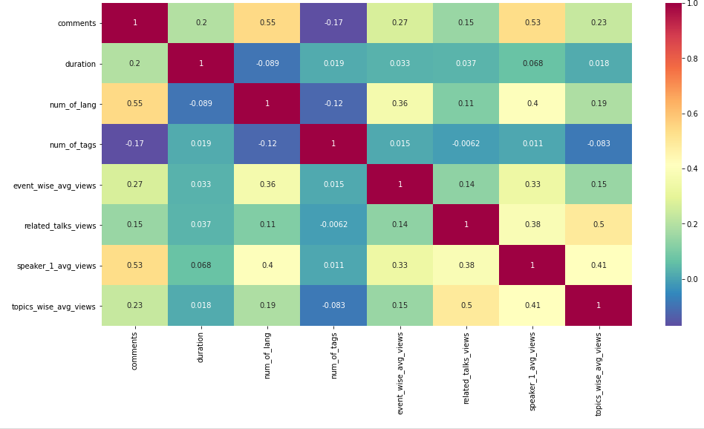
Collinearity

Slide 22
Modelling
Linear Regression Model
Random Forest Regressor
XGB Regressor

Slide 23
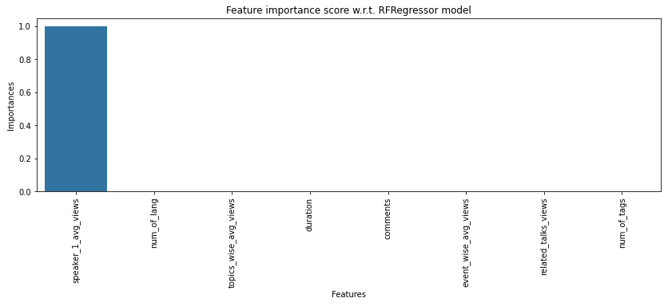
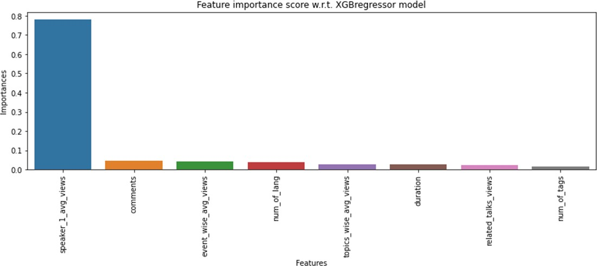
Feature Importance
Random Forest
Regressor
XGBoost Regressor

Slide 24

Model Selection
Out of all the models Random Forest Regressor is the best model according
to MAE
MAE is the best deciding factor because it is linear, and it is not affected by outliers.

Slide 25
Challenges
1. Dataset has lot of categorical features with high cardinality. So, its
conversion to meaningful numerical data was a tedious task.
2. Treatment of outliers in numerical features
3. Creation of new features to be added in the model
4. Selection of right features for modelling
5. Selection of right model with best scores

Slide 26
Conclusion
We have built a predictive model, which could help TED in predicting the views on the
talks uploaded on TEDx website.
In all these models our errors have been in the range of 2,00,000 which is around 10% of the average views. We have been able to correctly predict views 90% of the time. After hyper parameter tuning, we have prevented overfitting and decreased errors by regularizing and reducing learning rate. Given that only have 10% errors, our models have performed very well on unseen data due to various factors like feature selection, correct model selection.

Slide 27
Thank You

